Slide 1
Data Structures List, Stack, Queue
Georgi Lekov
Software Engineer
glekov@vmware.com
Talent boost Spring 2020

Slide 2
Why do we need to know about common data structures?
Lists
Stack
Queue(and relatives)
Write some code
… measuring actual data structure performance
3 Breaks: 9:45; 10:45; 11:45

Slide 3
What is a data structure?
A data structure is a data organization, management, and storage format that enables efficient access and modification.

Slide 4
And why should I care?
Some answers that shouldn’t really satisfy you:
It’s part of the curriculum, so, yeah…
They ask you about that stuff on interviews!
The above is true, but they are consequences of the real answer.
Musing around the real answer:
Algorithms + Data(Structures) = Programs (Niklaus Wirth)
Different ways of storing and organizing data have different properties (positives and negatives)
Not all programs do the same thing or run on the same hardware.
Disclaimer: 99.9% of the time, you can use an existing one instead of yours (and with better results)
PERFORMANCE!

Slide 5
Dynamic array
A linear data structure, where element are identified by indices or keys and the position of each element can be computed using that index.
Often it comes with restrictions like:
Stored elements should be of the same type(or at least of the same size).
Size of the array should be known beforehand.
Manual memory allocation should be carefully managed.
Implementation often rely on resizing the array, when element addition requires it.

Slide 6
1
2
3
4
5
6
7
8
9
10
1
2
3
4
5
6
7
8
9
10
11
1 | 2 | 3 | 4 | 5 | 6 | 7 | 8 | 9 | 10 | 11 | 12 | 13 | 14 | 15 | 16 | 17 | 18 | 19 | 20 | 21 | 22 |  |  |  | …
So, what is the complexity of element addition?
Amortized?

Slide 7
Operations complexity
Time complexity of array operations
Memory complexity
new ArrayList<E>()
E get(int index), void set(int index, E element)
void add(E element)
E remove(int index)
int findIndex(E element)
O(1) (allocating memory, but no elements added)
O(1) (random access after all)
O(1) (amortized)
O(n)
O(n)
O(n)

Slide 8
Linked List
A structure that orders its elements sequentially.
The elements are not stored in sequential memory.
Each element has a pointer to the next element in the list.
No random access.

Slide 9
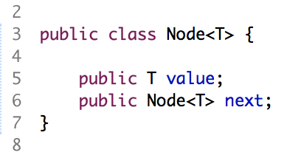
Node
Some data
Pointer to next node
Data

Slide 10
Add element
tail
1
2
null
head
Add 3
Node newNode = new Node(3);
tail.next = newNode;
tail = newNode;
3
null
1
2
3
null
head
tail

Slide 11
Insert element
1
2
3
null
Insert 5 at position 2
head
tail
1
2
3
null
head
tail
5

Slide 12
Delete element
Delete element at position 2
1
2
5
3
null

Slide 13
Operations complexity
Time complexity of linked list operations
new LinkedList<E>()
E get(int index), void set(int index, E element)
void add(E element)
E remove(int index)
void insert(int index, E element)
E removeFirst(), E removeLast()
O(1)
O(n)
O(1)
O(n)
O(n)
O(1)

Slide 14
Implement LinkedList
Download and implemented LinkedListStubs.java from github

Slide 15
Stack ADT

Slide 16
Stack ADT
A linear data structure, where element can only be added or removed at one of its ends.

Slide 17
Stack ADT
LIFO(last in, fist out) data structure.
Stack based process is actually used pretty often:
When packing/unpacking luggage or taking out groceries.
Also undo/redo in computer software.
When we are decomposing big problem into smaller subproblems and so on.
In computer science, for storing data about the active subroutines of a computer program(call/execution stack).
Recursion works naturally with stack-based processing.

Slide 18
Implementation approaches and operations complexity
Implementation approaches
Using sequential memory allocation.
Using linked memory allocation(linked list).
Time complexity of stack operations
void/boolean push(E element)
E pop()
E peek()
int size()
boolean isEmpty()
O(1)
O(1)
O(1)
O(1)
O(1)

Slide 19
Queue ADT

Slide 20
Queue ATD
A linear data structure, where elements are added at its back and removed at its front.

Slide 21
Queue ADT
FIFO(first in, first out) data structure
“First out” here may refer to first by criteria other than order of submission.
Queue-based processing is maybe the most often used strategy for storing and consecutively processing data:
When assessing students homeworks…
When scheduling tasks for processing(with or w/o prioritizing).
One of the most often used data structure for various aspects of concurrent programming
Blocking queue
Many efficient algorithms, using queues, are used in concurrent environments

Slide 22
Different variations of queues
Deque
Double-ended queue, where elements can be added or removed at both ends.
Priority queue
Elements are additionally assigned priority.
“First out” here refers to the element with the highest priority.

Slide 23
Operations complexity
Time complexity for queue operations
void/boolean enqueue(E element)
E dequeue()
E peek()
int size()
boolean isEmpty()
O(1)
O(1)
O(1)
O(1)
O(1)

Slide 24
Recap

Slide 25
Time Complexity comparison
Operation | Dynamic Array | Singly Linked List
Traversal | O(N) | O(N)
Insertion | O(N) | O(1)
Deletion | O(N) | O(1)
Selection | O(1) | O(N)
Memory | O(N) | O(N) + bookkeeping
Let’s do some profiling!
Notes:
Data Structures are internally implemented either with an Array or a List.
Array:
Fast Access - O(1)
Slow Resize - O(n)
Llist:
Variable size
Slow access to middle

Slide 26
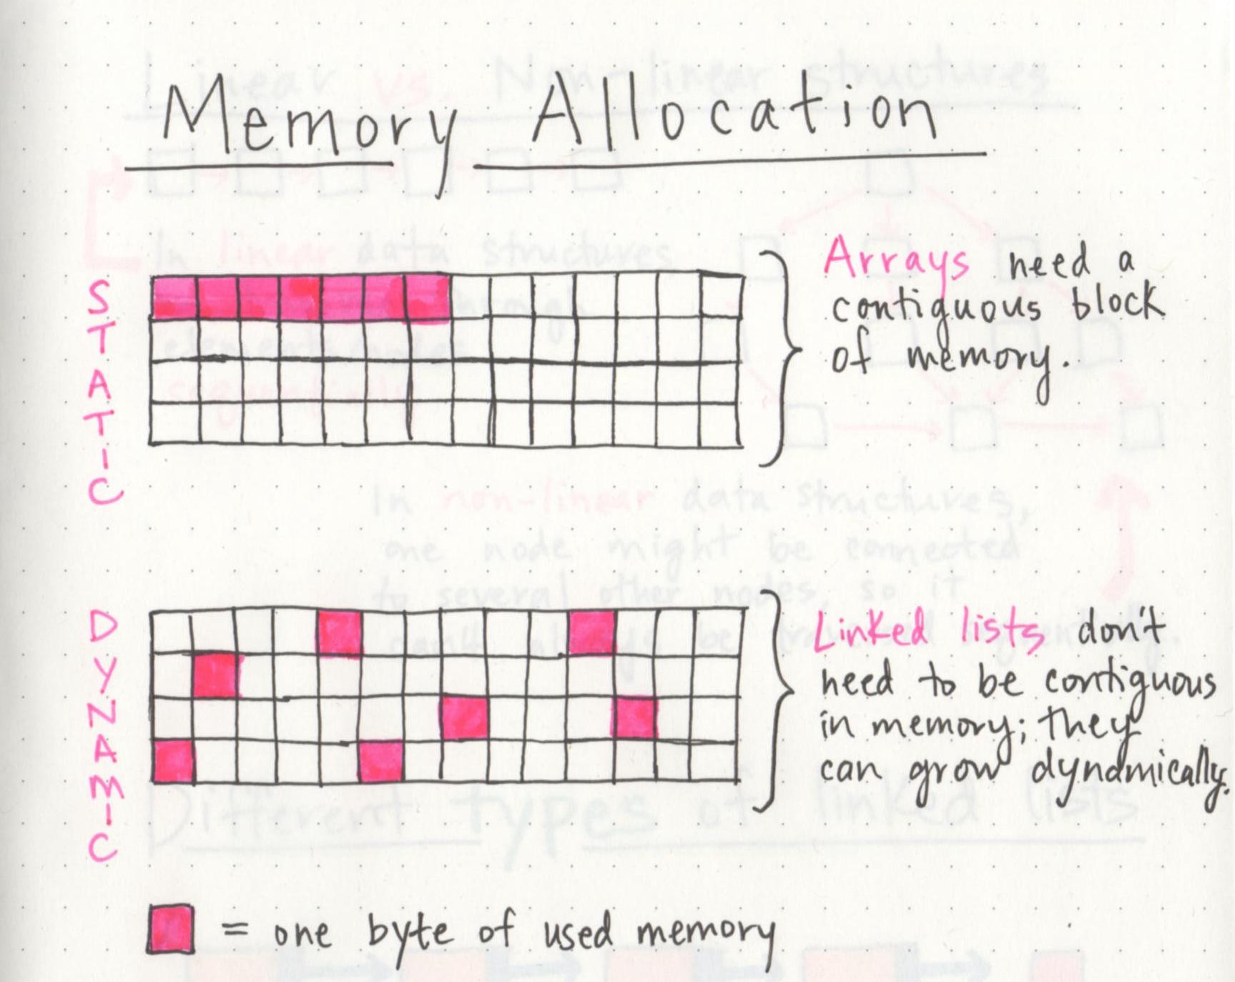
Spatial and temporal locality

Slide 27
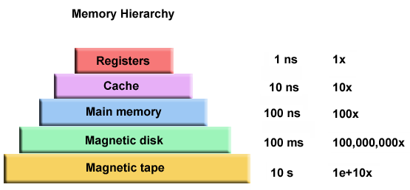
http://www.overbyte.com.au/misc/Lesson3/CacheFun.html
Notes:
Why is Main Memory faster than Cache?
Why don’t we make everything a Cache?

Slide 28
Array faster than List?
Benchmarking to the rescue:
https://baptiste-wicht.com/posts/2012/12/cpp-benchmark-vector-list-deque.html

